Slide 1
Manufacturing downtime analysis tool: MS-excel Project by: Maven Analytics

Slide 2
agenda
Understanding Business Problem
Dataset Exploration
Calculate Line Efficiency
Identify Main Downtime Factors
Calculate Downtime by Operator & Factor
Final insights & recommendations to Stakeholders

Slide 3

Business problem Identify productivity improvement opportunities in a production line

Slide 4
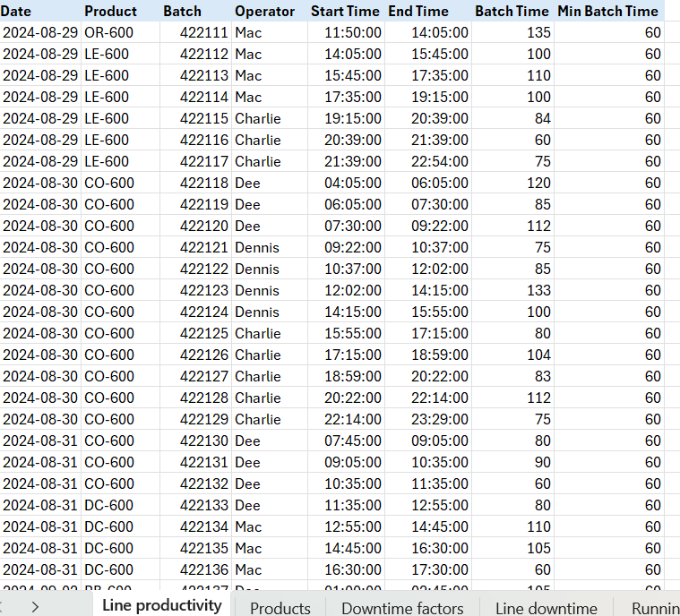
Dataset exploration

Slide 5
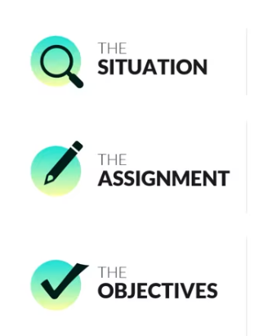

How do we proceed?
We will first analyze the situation.
Then we Explore, Manipulate and Analyze the Data.
And based on the objective we will find out the insights.
At last, we will share recommendations to stakeholders based on our insights.

Slide 6
3 Objectives of this project:
1. Calculate line efficiency
Your first objective is to calculate the efficiency for a production line and break it down by operator.
2. Identify main downtime factors
Your second objective is to use a Pareto chart to identify the main factors for downtime in the production line.
3. Calculate downtime by operator & factor
Your final objective is to use a matrix to calculate the total downtime by operator for each of the main factors you identified.

Slide 7
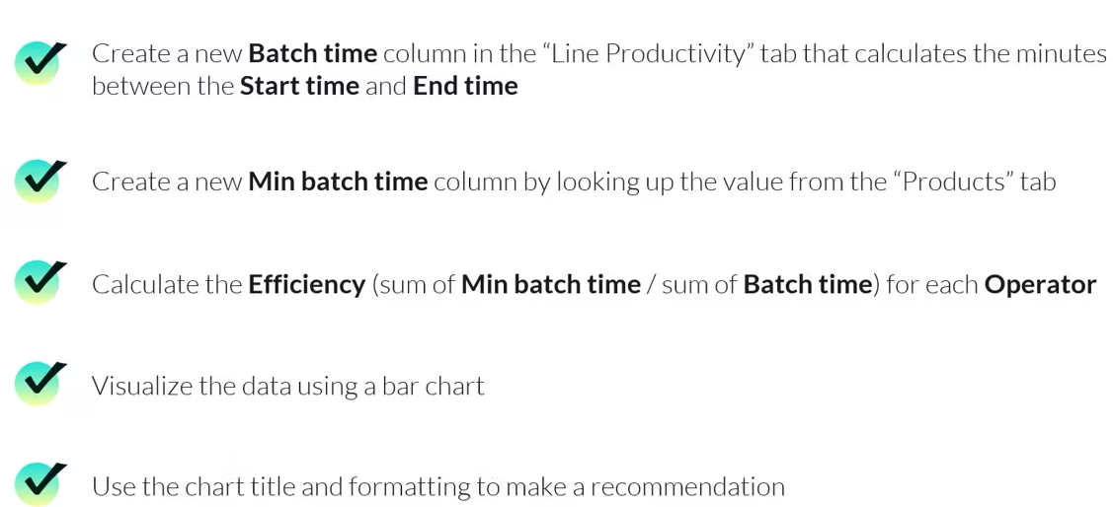
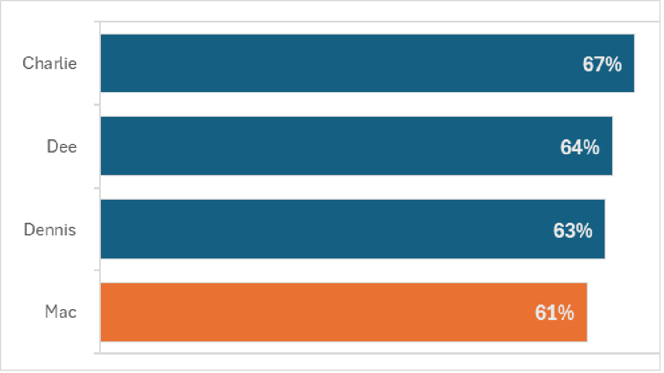
Objective-1 Calculating line efficiency
INSIGHT:
Overall efficiency sits at 64%.
We should place special focus on Mac.

Slide 8
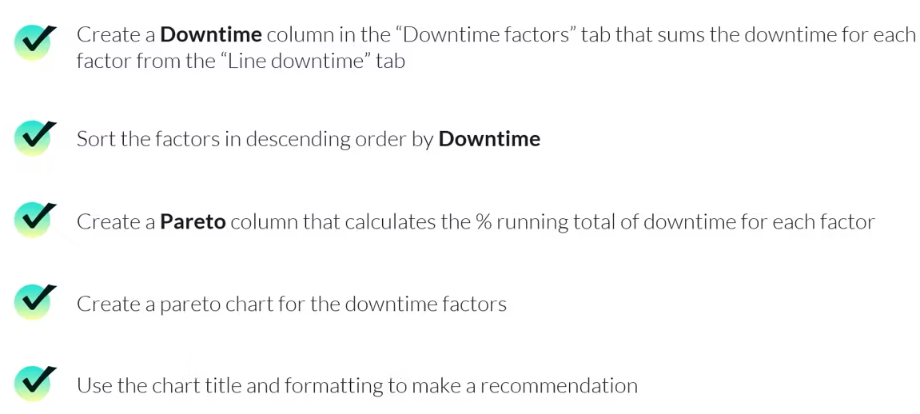
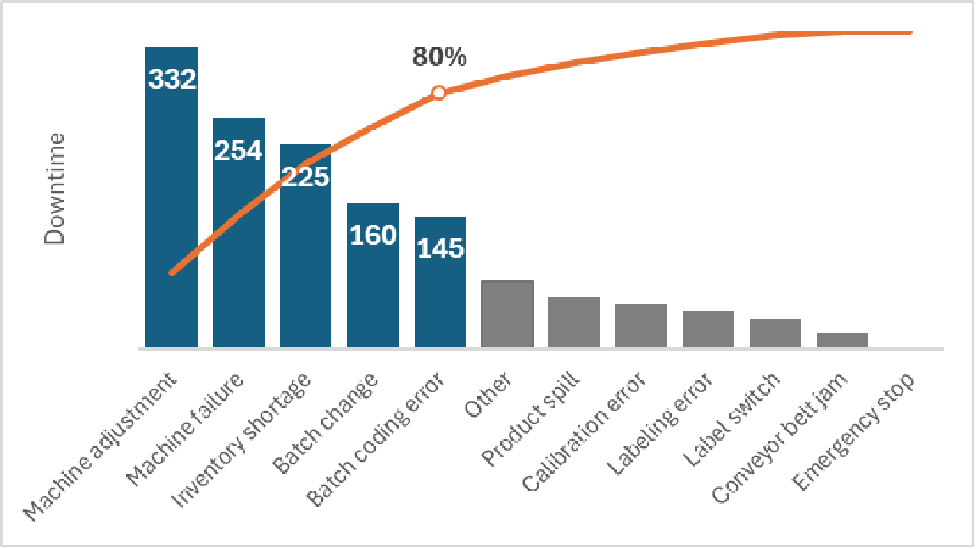
Objective-2 Identify main downtime factors
INSIGHT:
The top 5 factors account for the 80% of downtime.
So we should ignore rest and prioritize these.

Slide 9
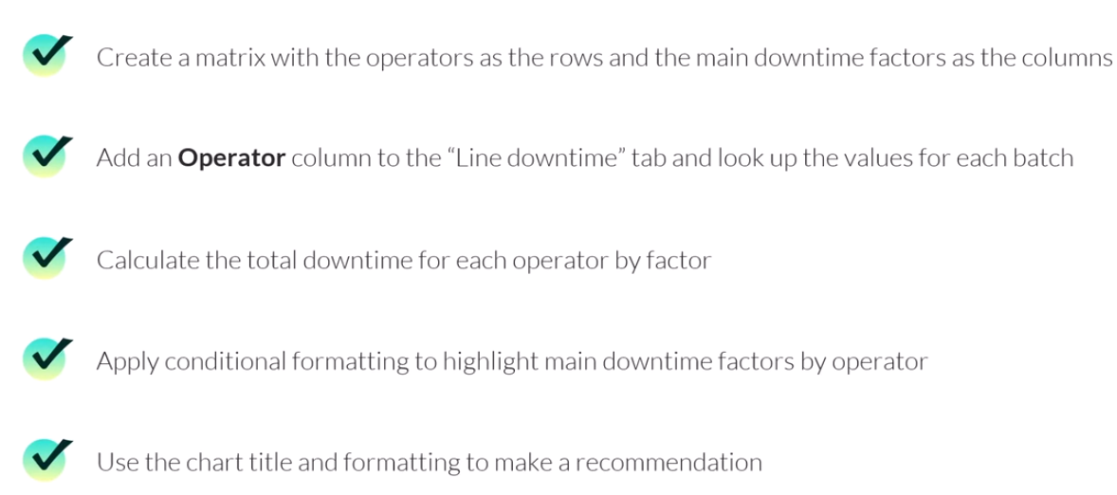
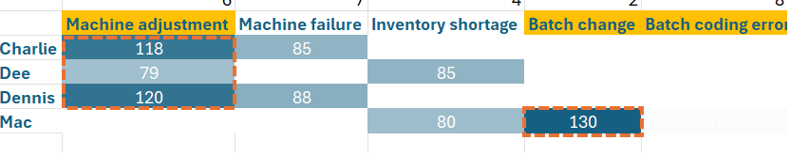
Objective-3 calculate downtime by operator & factor
INSIGHT:
3 of the main 5 downtime factors are due to operator error
We should focus on Machine adjustments for everyone and Batch change for Mac.

Slide 10

Recommendation to stakeholder:
On the basis of our Data Analysis, we would recommend the following to the Stakeholders:
1. ) Start with Machine adjustment training for all operators.
2. ) Provide special batch change training for Mac.
3. ) Apply preventing maintenance to machine and double check inventory levels.
values, and emotions of those listening

Slide 11
Thank you
Madhu Pincha
Contact:
mpincha1999@gmail.com
https://www.linkedin.com/in/madhu-pincha/

